Slide 1
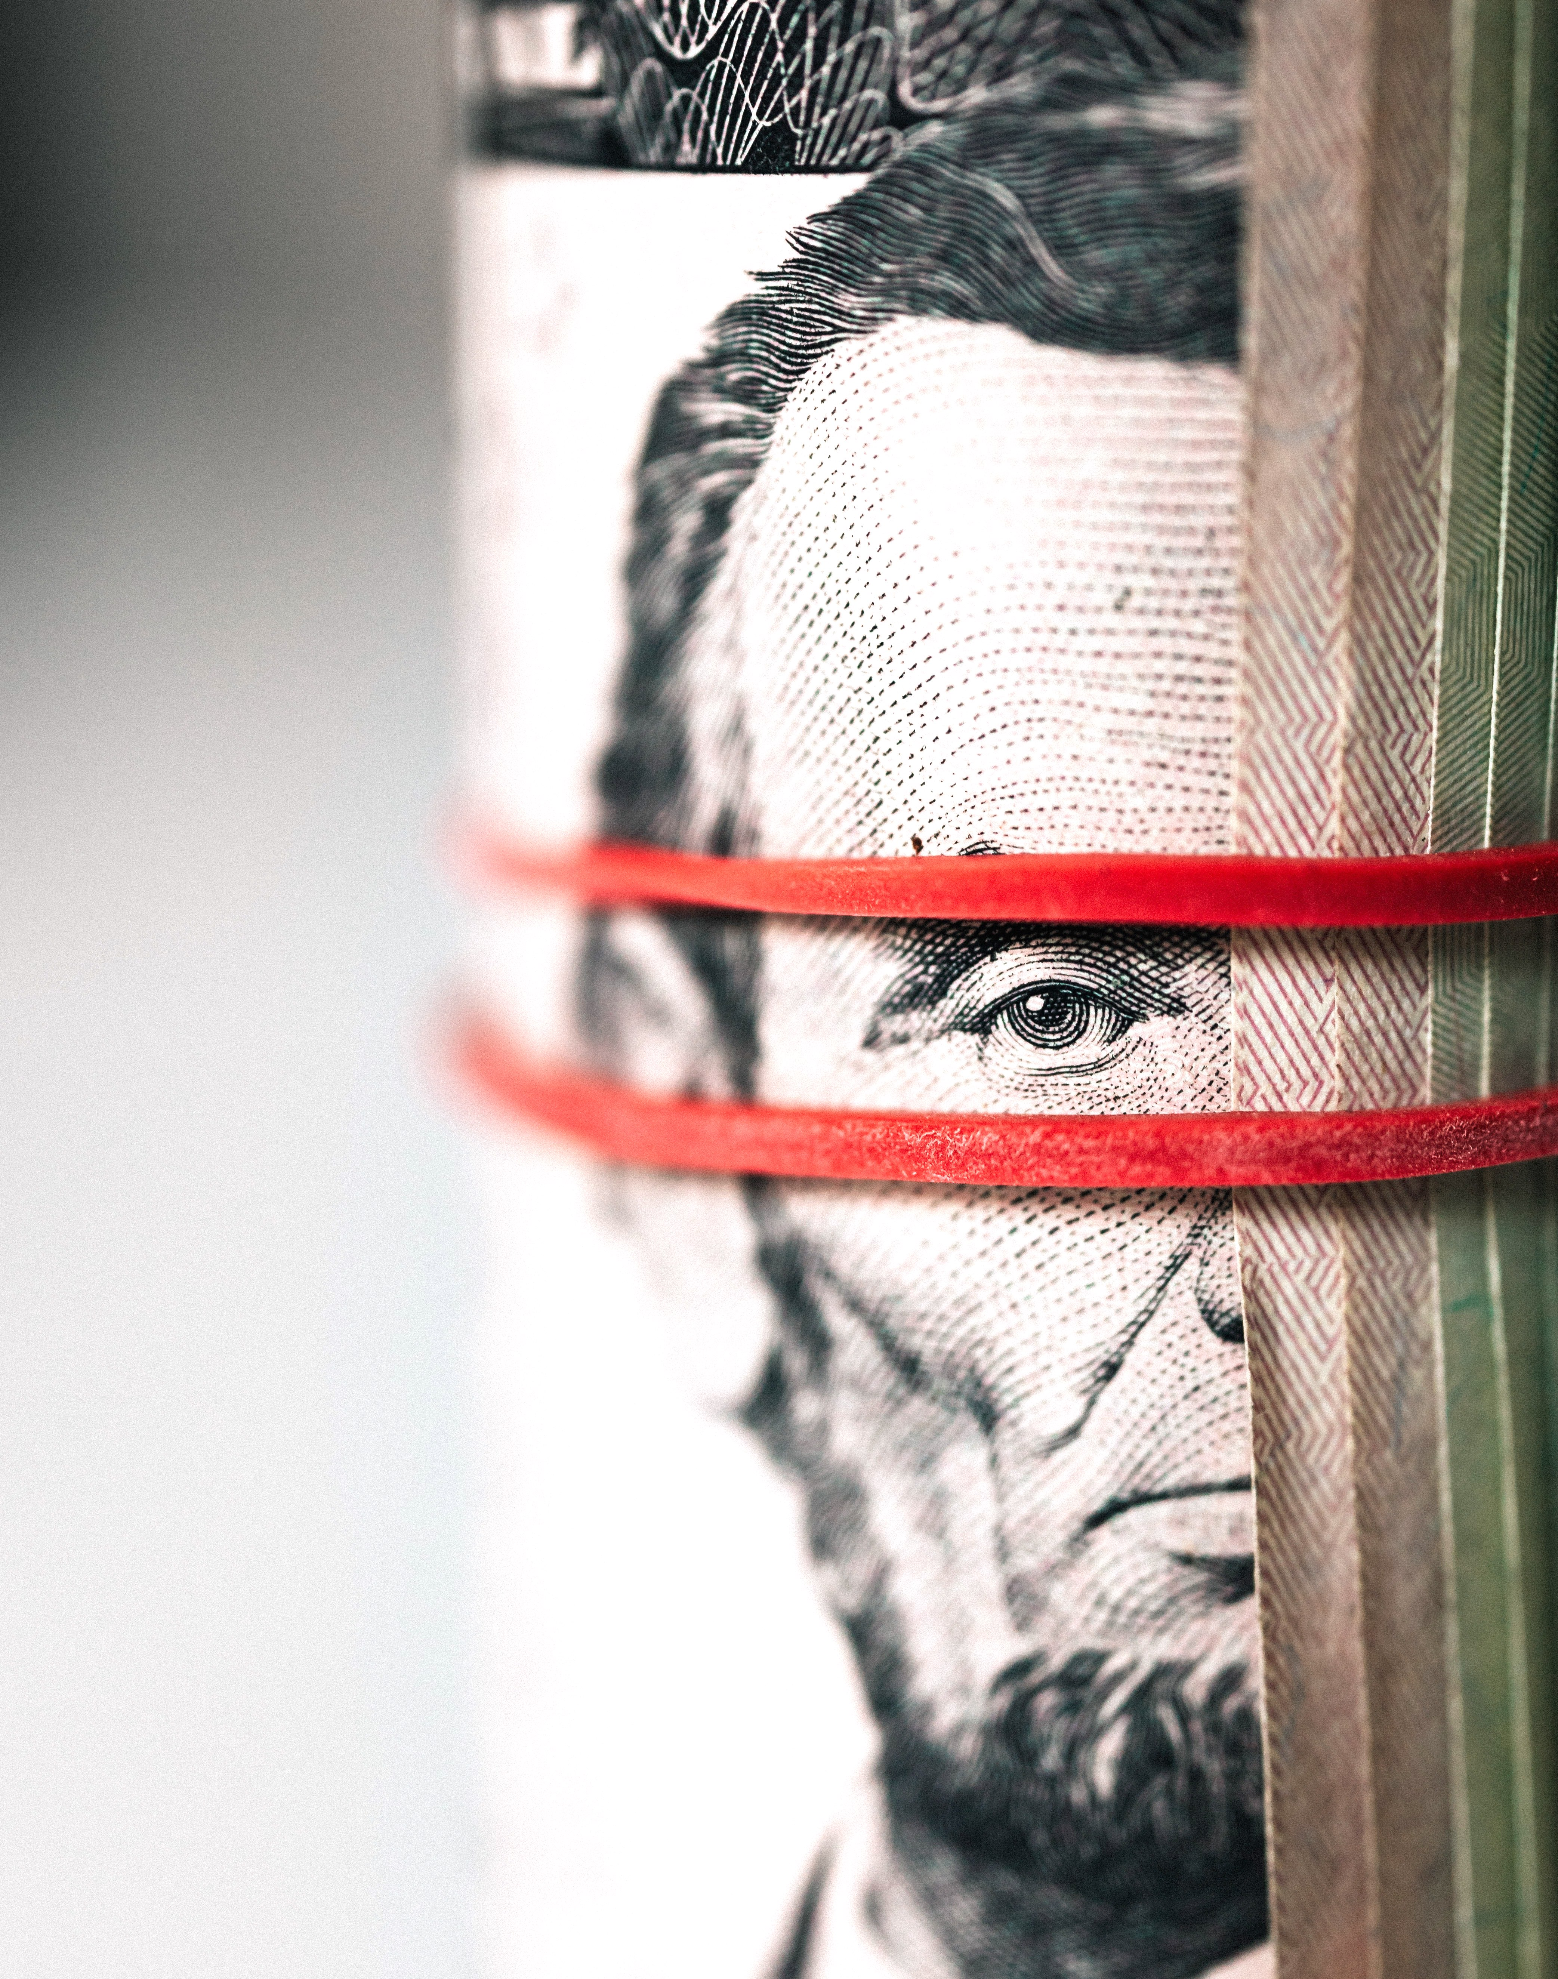
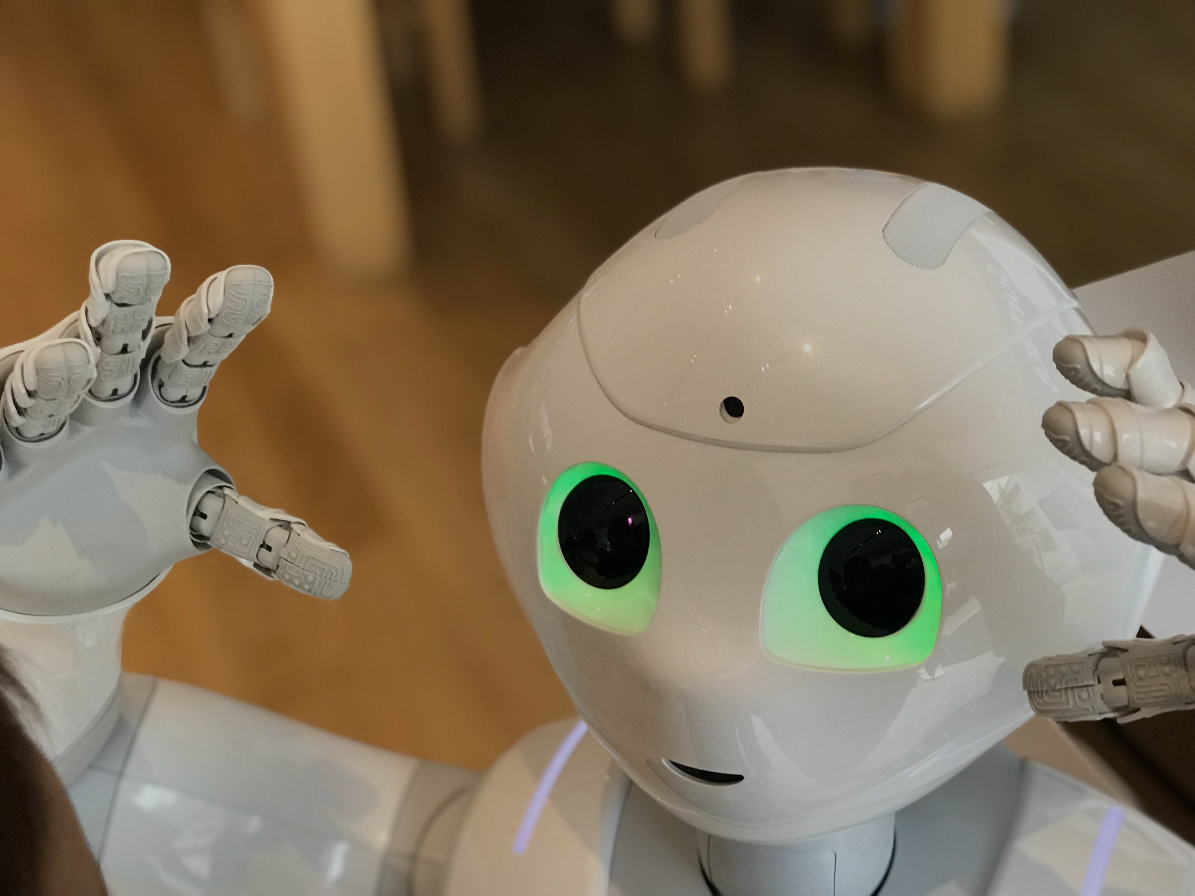
Prof. Luis Seco
Sustainability, Technology and
the birth of the Social FinTech

Slide 2
UN Sustainability Goals
1 | NO POVERTY
2 | ZERO HUNGER
3 | GOOD HEALTH AND WELL-BEING
4 | QUALITY EDUCATION
5 | GENDER EQUALITY
6 | CLEAN WATER AND SANITATION
7 | AFFORDABLE AND CLEAN ENERGY
8 | DECENT WORK AND ECONOMIC GROWTH
9 | INDUSTRY, INNOVATION AND INFRASTRUCTURE
10 | REDUCED INEQUALITIES
11 | SUSTAINABLE CITIES AND COMMUNITIES
12 | RESPONSIBLE CONSUMPTION AND PRODUCTION
13 | CLIMATE ACTION
14 | LIFE BELOW WATER
15 | LIFE ON LAND
16 | PEACE, JUSTICE AND STRONG INSTITUTIONS
17 | PARTNERSHIPS FOR THE GOALS

Slide 3
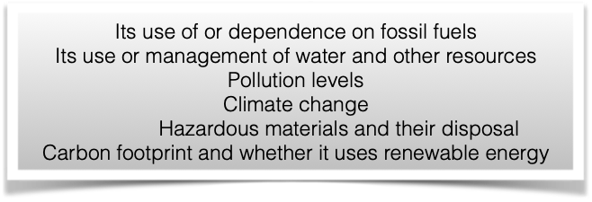
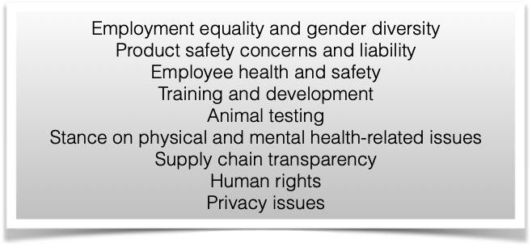
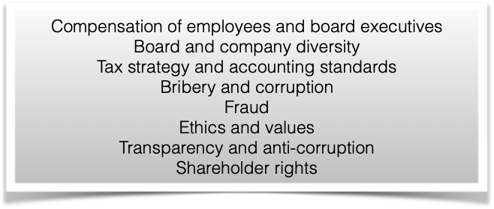
ESG
E pillar
S pillar
G pillar

Slide 4
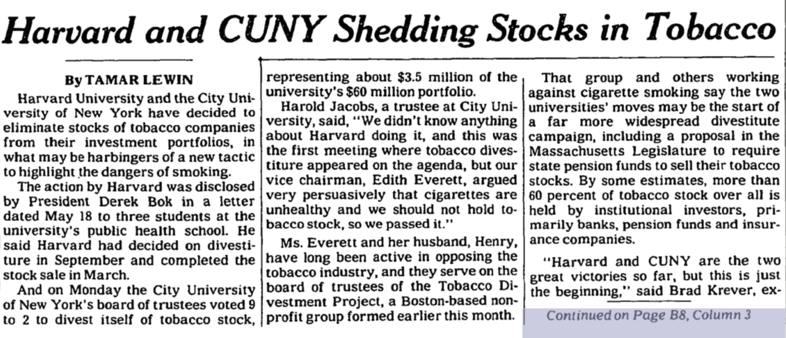
Socially responsible investing
May 24, 1990

Slide 5
A Risk trade
1990
$
Profitability
Today
Tobacco
Companies
Law-suits
Tomorrow
2020

Slide 6
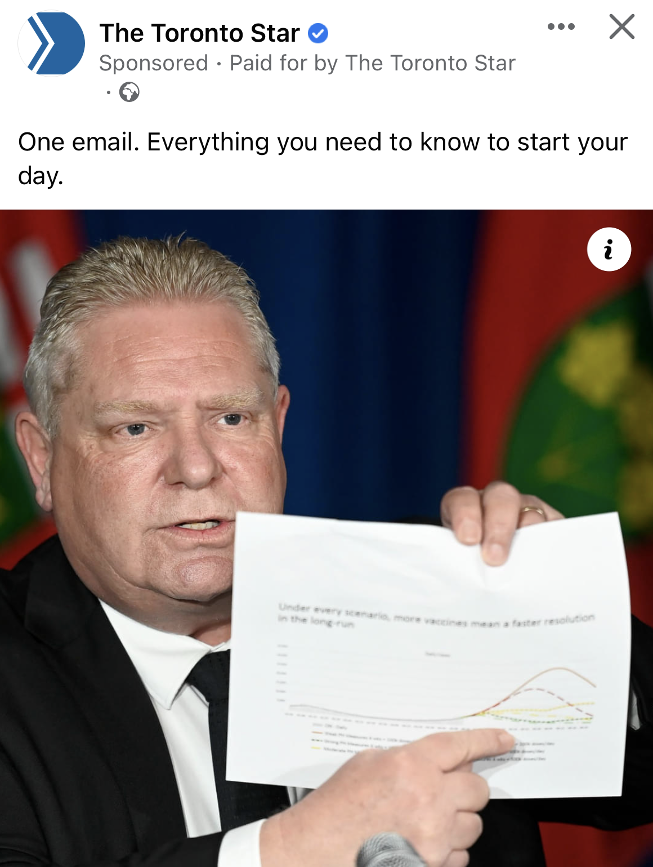
The Center for Sustainable Development
Fields & COVID
2020-2022
Our Lesson:
AI is useful for social emergencies
Center for
sustainable development
Premier of the Province holding
a Fields-COVID report

Slide 7
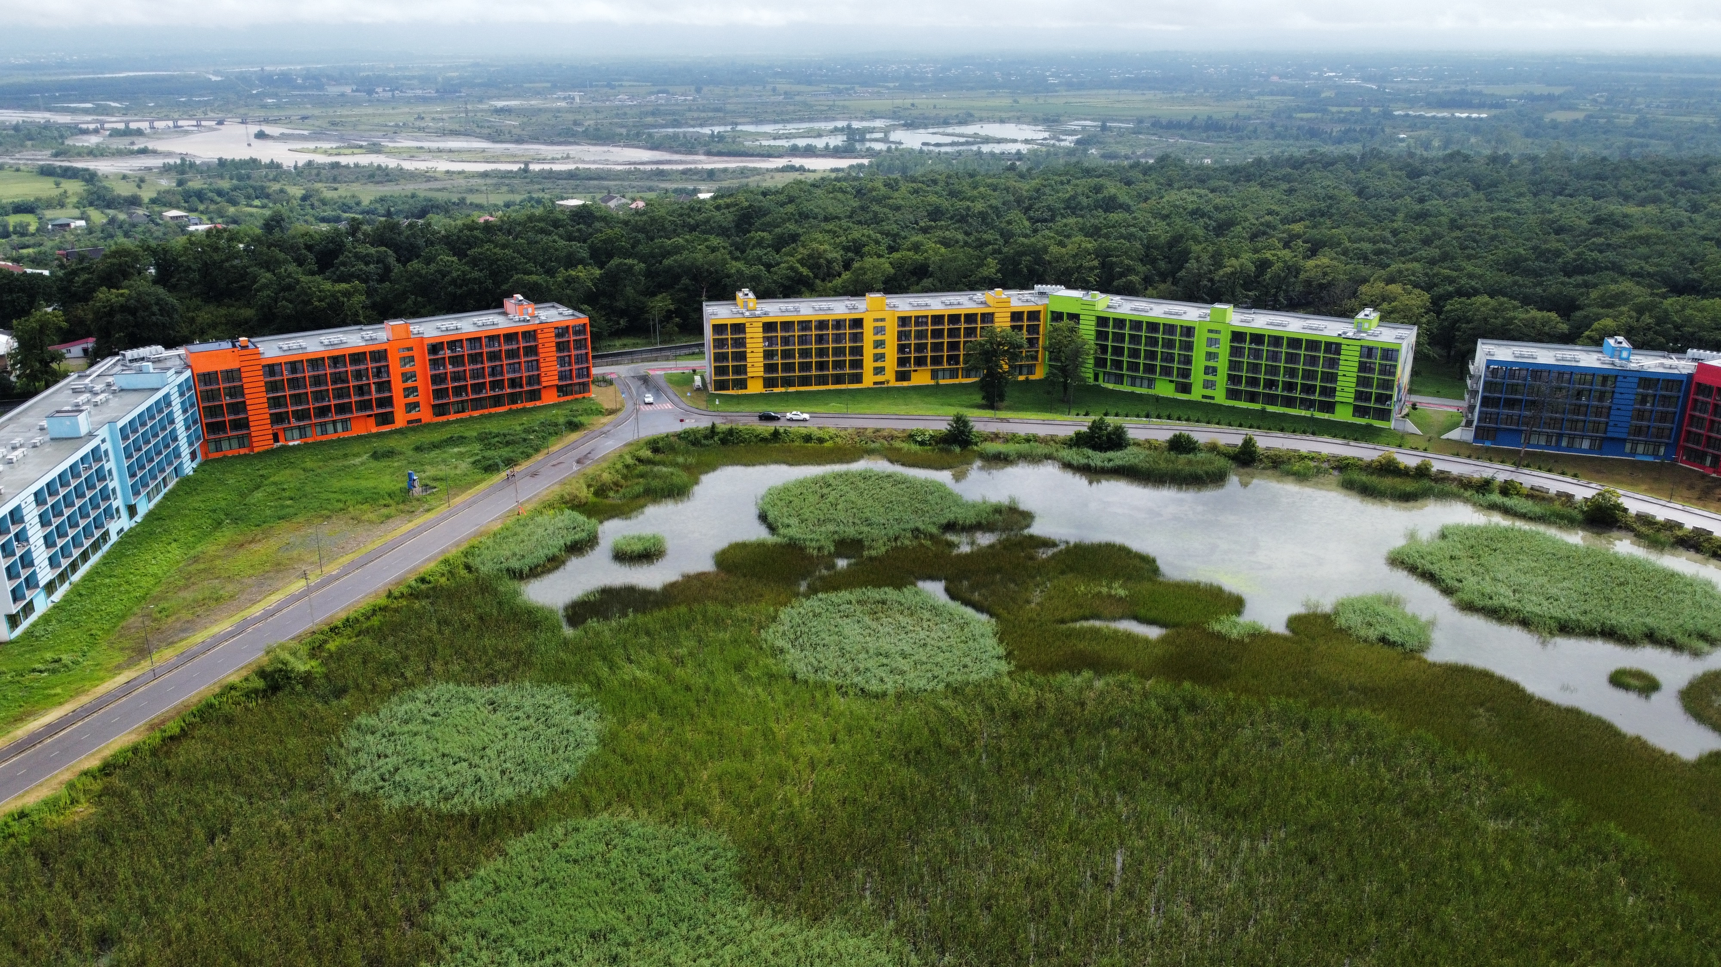
A new urban paradigm
The new garden:
CO2 credits
Agro platform
Cooling system
Revenue generator:
CO2 credits
biodiversity credits
Water exchange

Slide 8
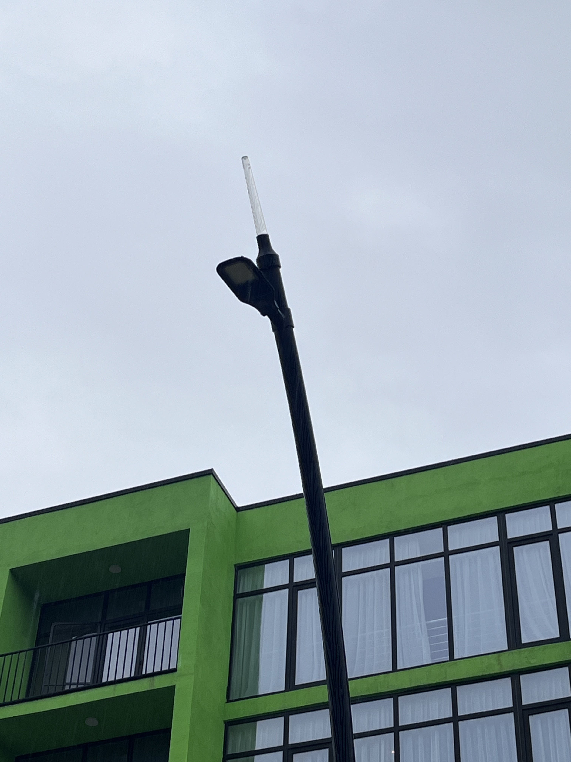
The Good City
Data collector:
CO2
rain fall
traffic
temperature
biodiversity monitor

Slide 9
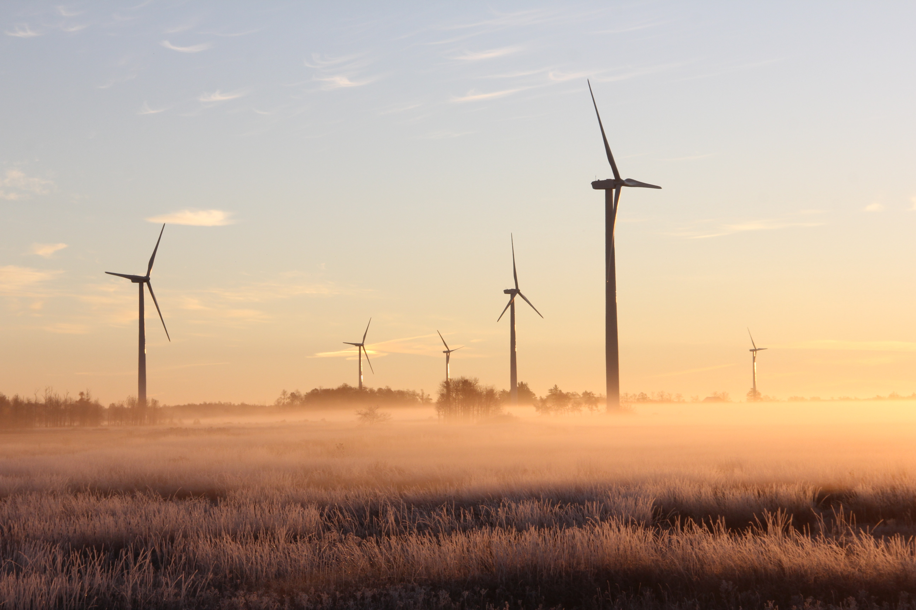
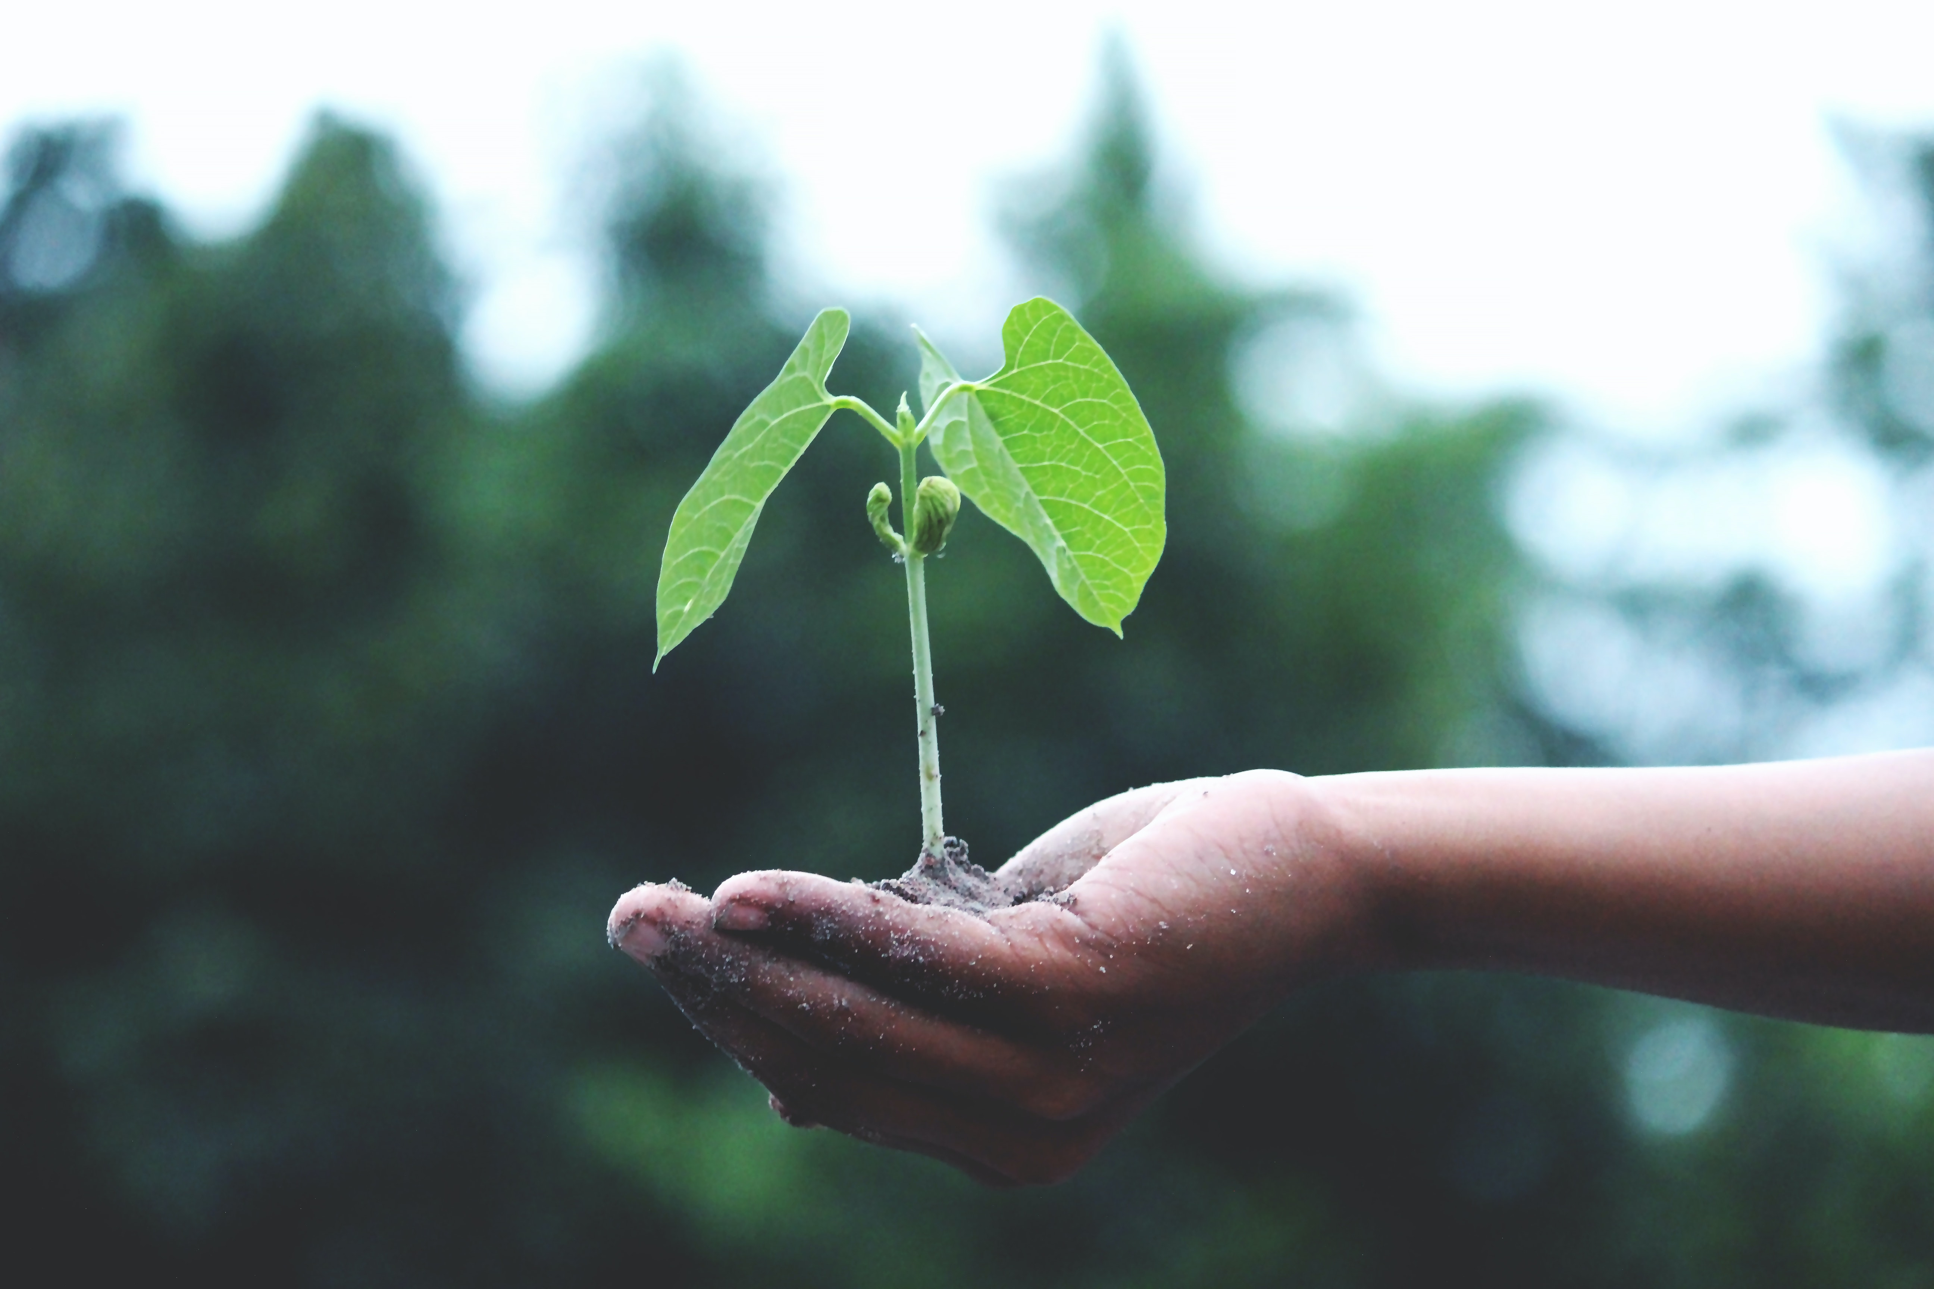
Sustainability: the new liability

Slide 10
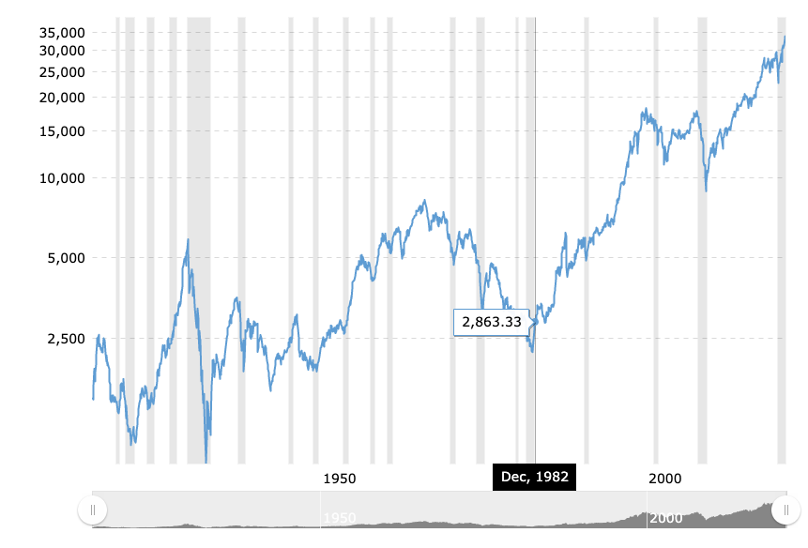
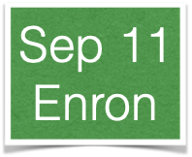
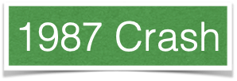
100 years of failures
Futures (1697)
Bonds (1694)
Stocks
Derivatives
QE
6 bank failures
per year (USA)
Structured Credit

Slide 11
Events and regulation
Event | Regulation
1929 Crash | Securities ACT (1933)
Enron | SOX (2002)
2008 | Dodd-Frank (2010)
? | Data Regulation?
COVID-19 | Stay@home/Rate hikes
Climate Risk | Article 2.1.c of the Paris accord
How will data be regulated?

Slide 12
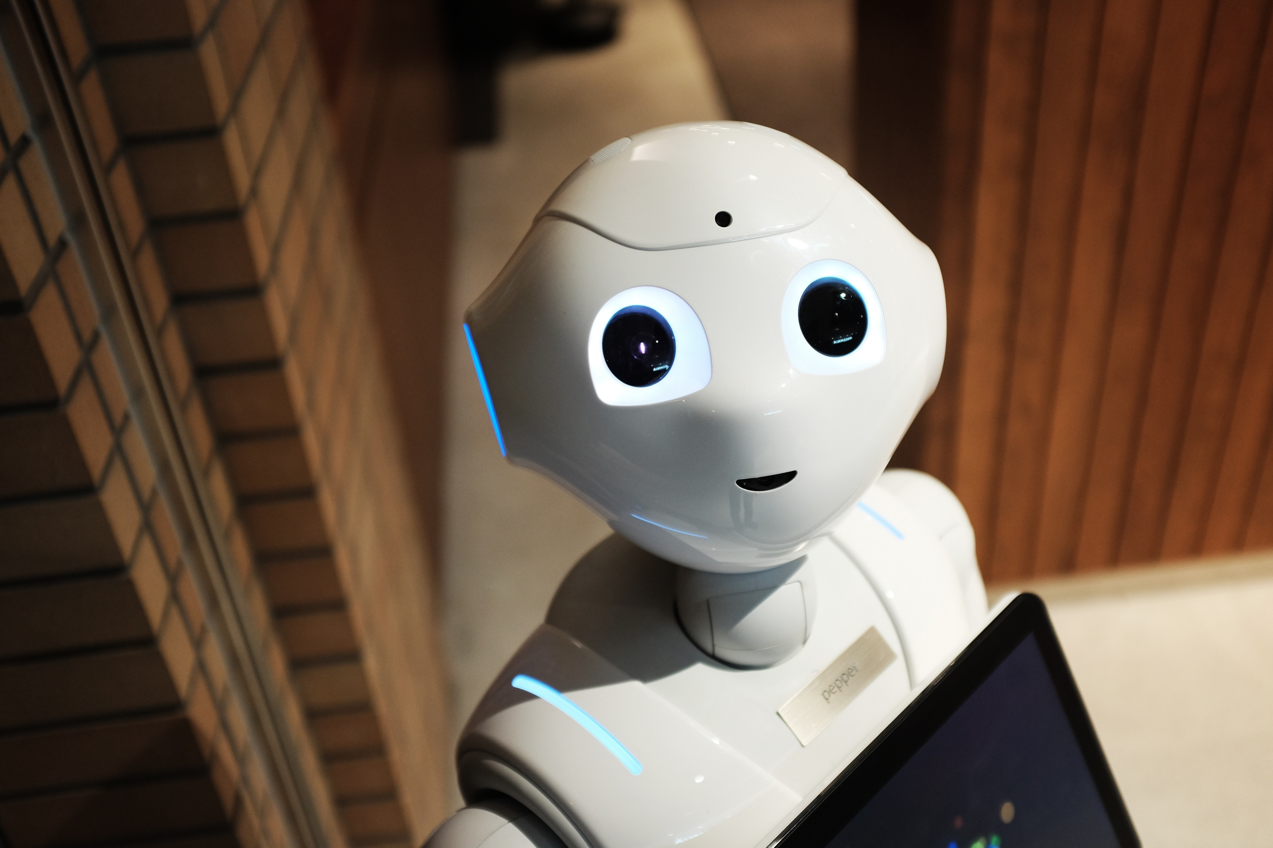
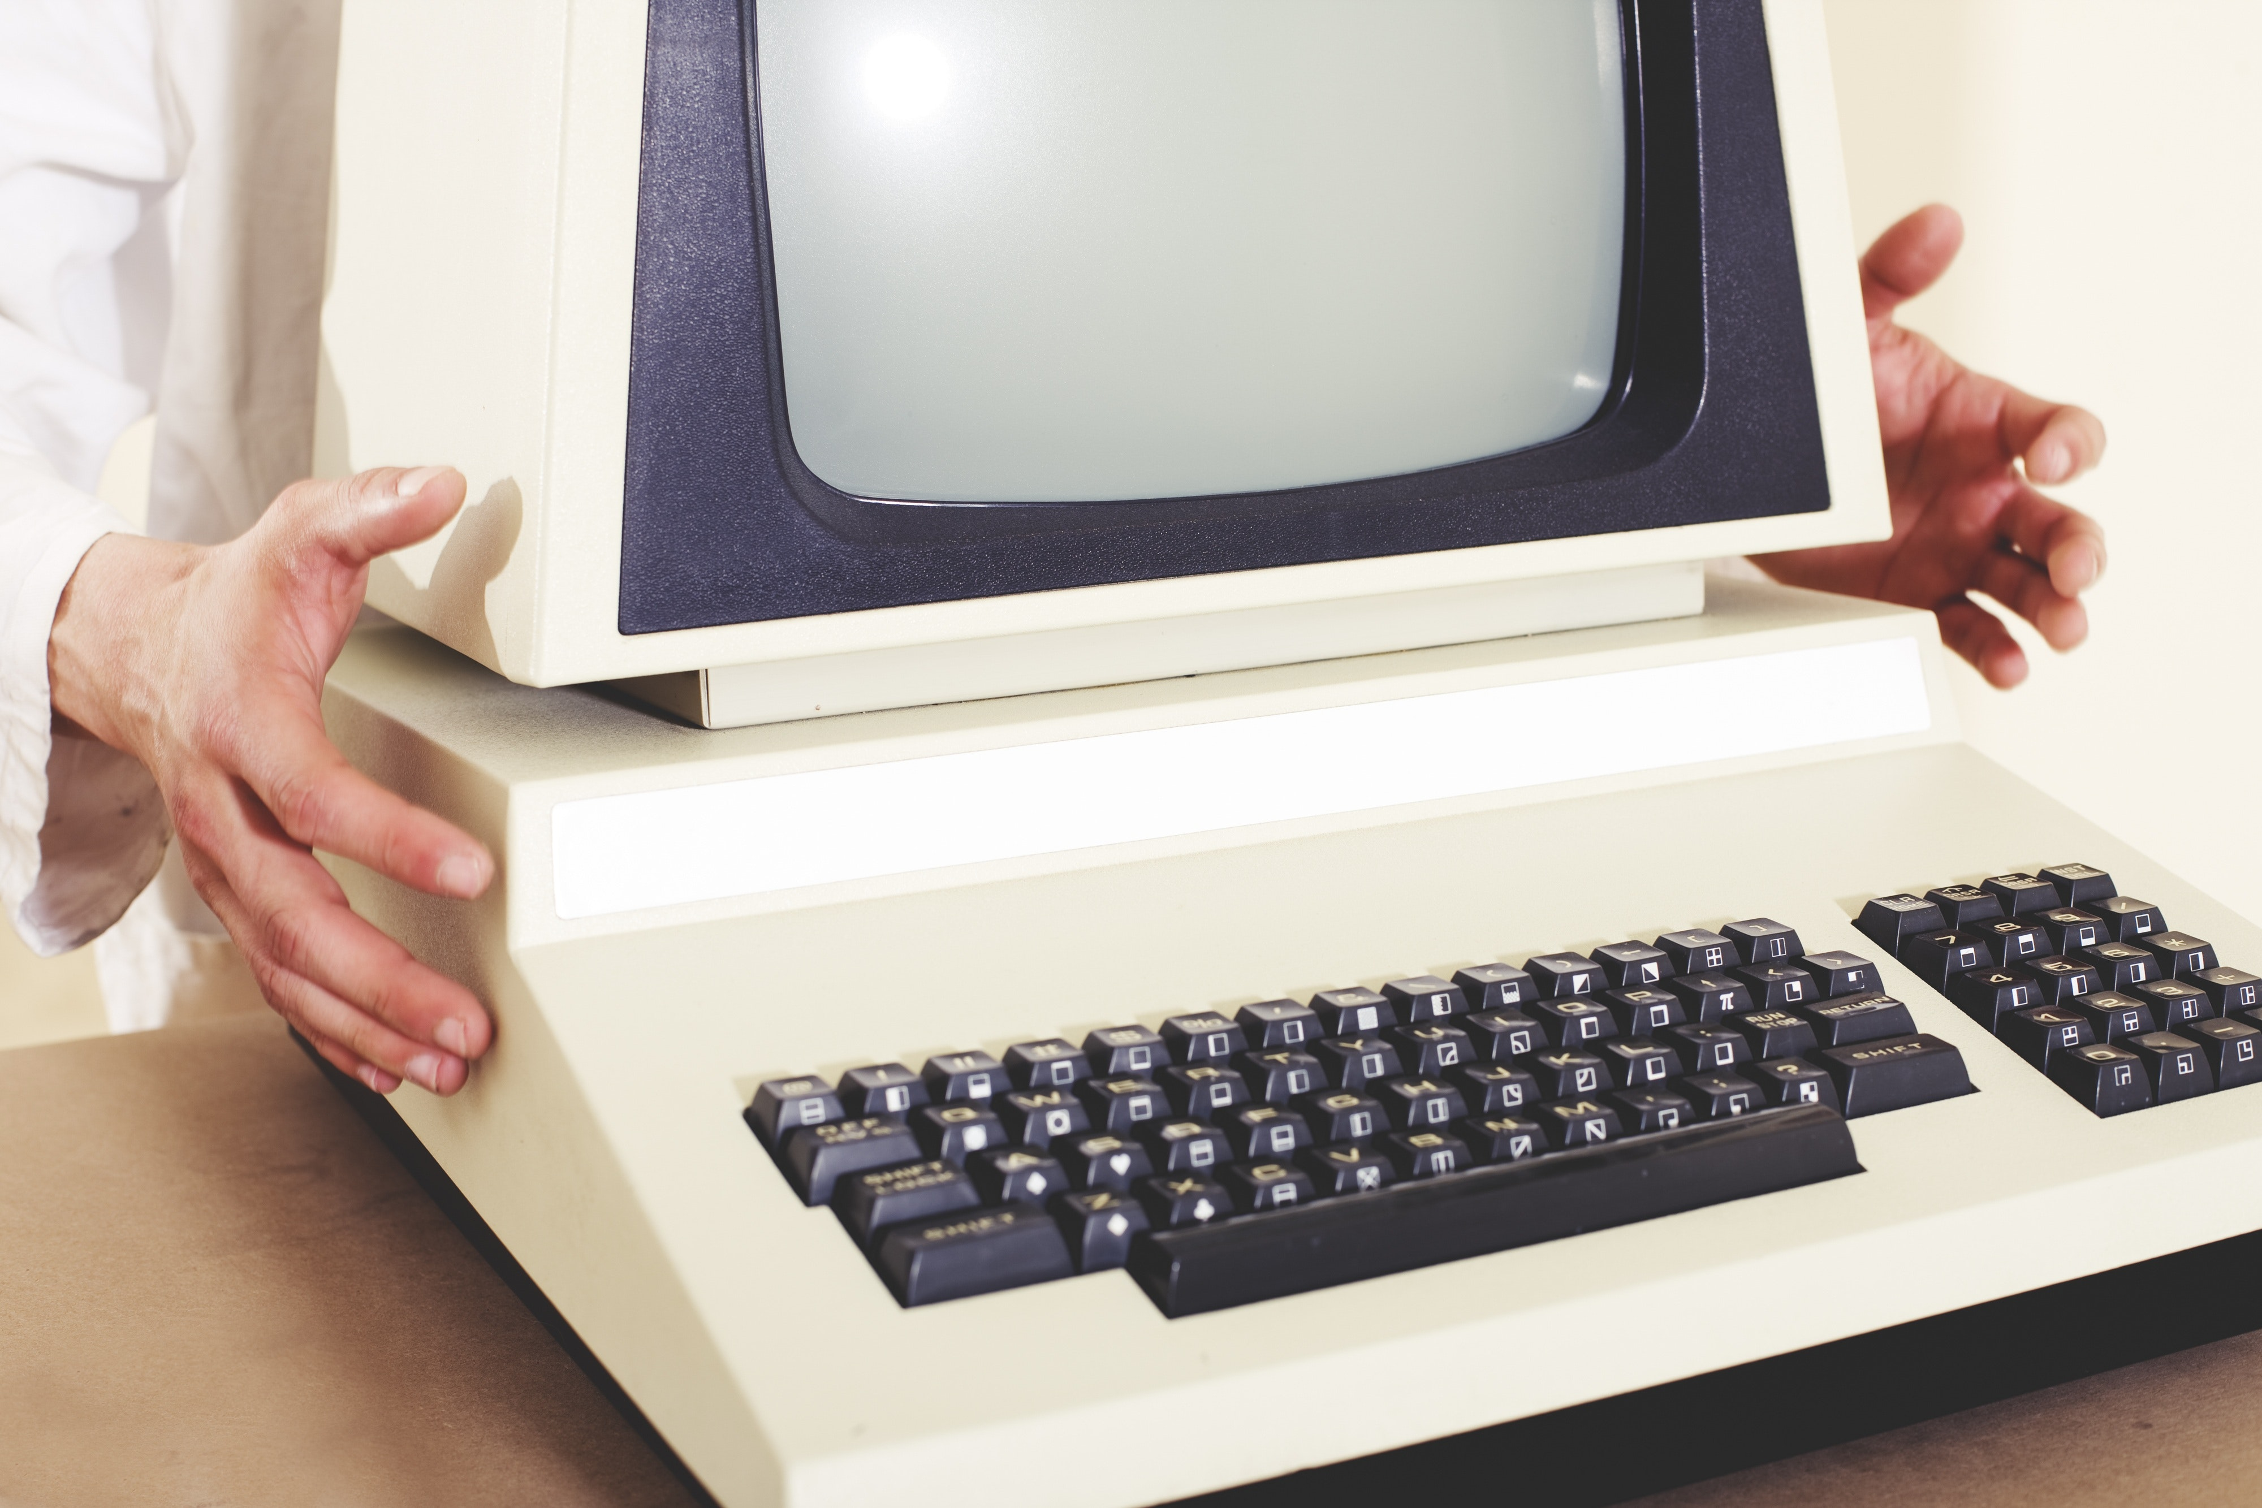
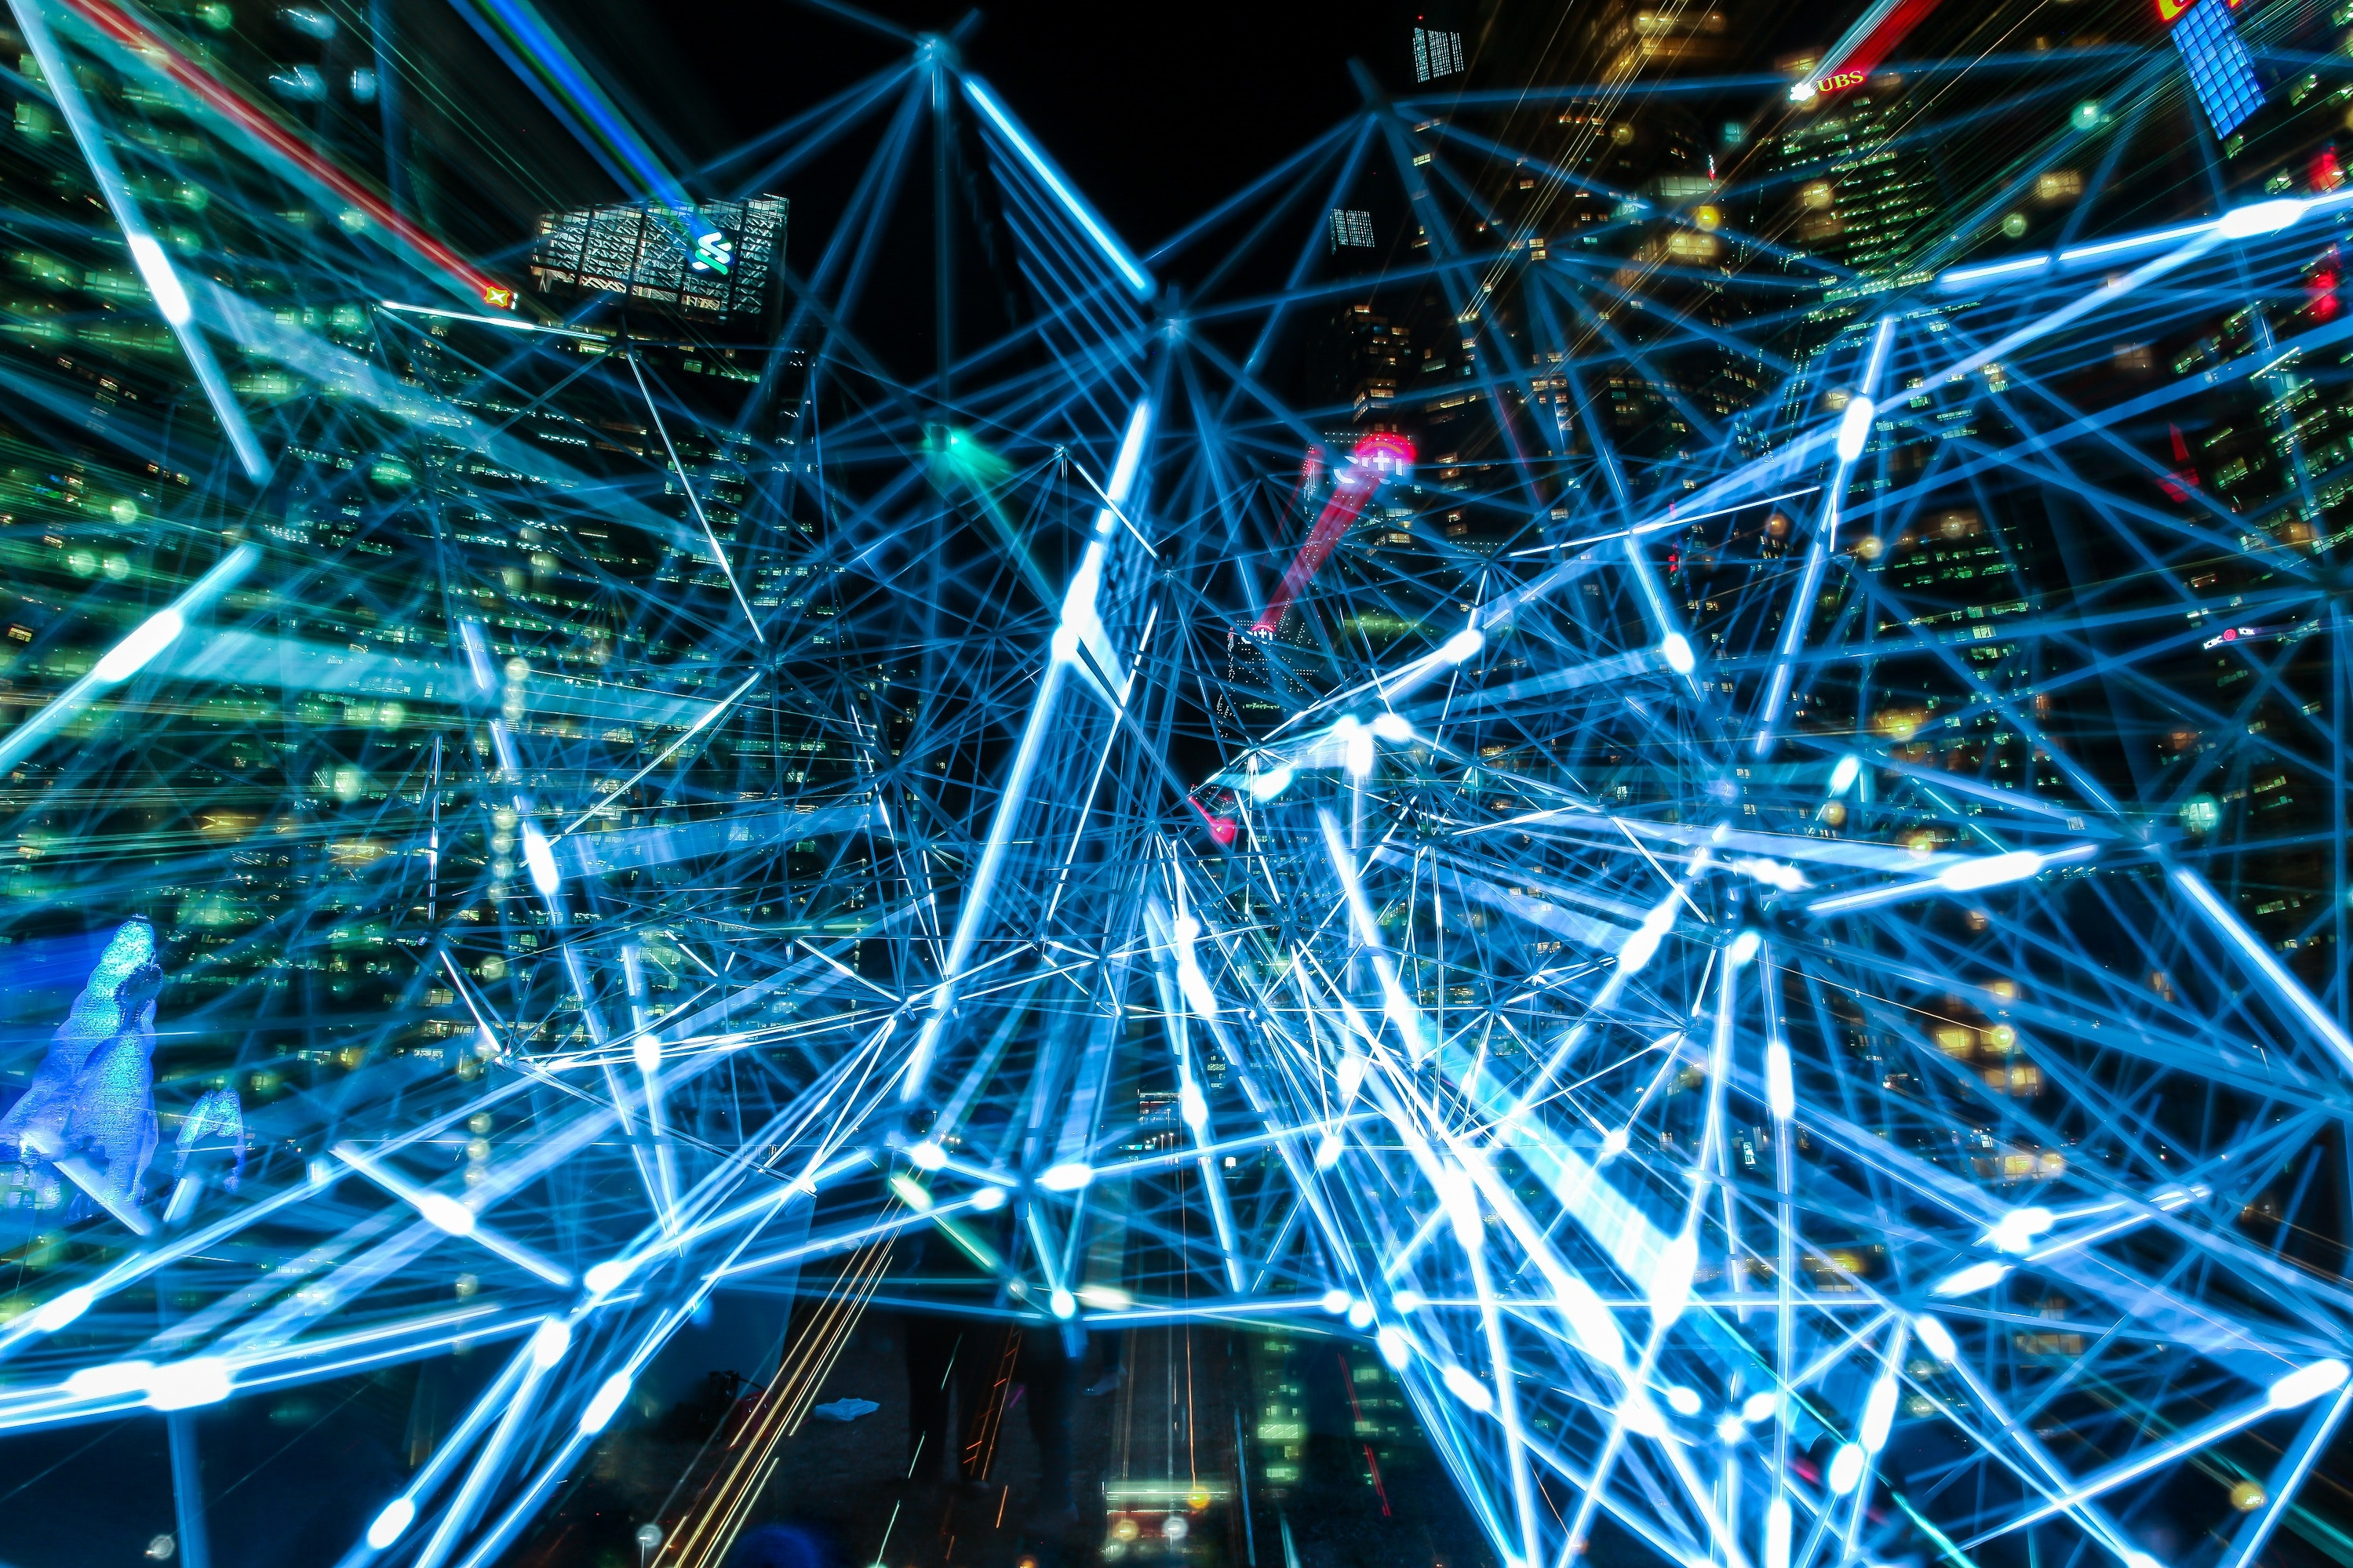
100 Years to Artificial Intelligence
1930
1950
2000
2020
2030
Harry Markowitz realized
no value was given to
RISK
ML
AI
ESG
NLP
Social
Behavioral
"Portfolio Selection," Journal of Finance. 1952
languished on dusty library shelves
only four of the 14 pages contained text
John Burr Williams,
The Theory of Investment Value
value of a stock given by
current value of future dividends.
A plethora of quant methods
started with the ubiquity of the PC
Find a good stock
buy it at the best price.
Climate Risk
article 2.1.c of the Paris Accord

Slide 13
Data inputs
1930
1950
2000
2020
Rich
“Bloomberg-type”
Time series
Company
accounting
information
News
Web
Social media
Documents
Filings
…

Slide 14
Environment
Green Power stocks
Water supply
Renewable energy
Pollution control
Green transportation
Waste reduction

Slide 15
Business Impact of Climate Change
Understand cognitive challenges
Develop a “Risk Thinking” methodology
Business development:
Urban design
Carbon trading: digital assets
Green finance

Slide 16
Social
Community impact
Minorities

Slide 17
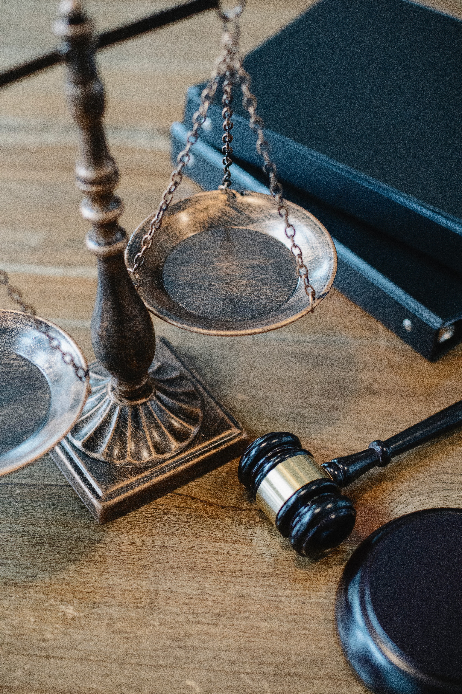
Governance
Principles
Processes
Ethics
Regulation
Compliance

Slide 18
Social Investing
Portfolios that sell

Slide 19
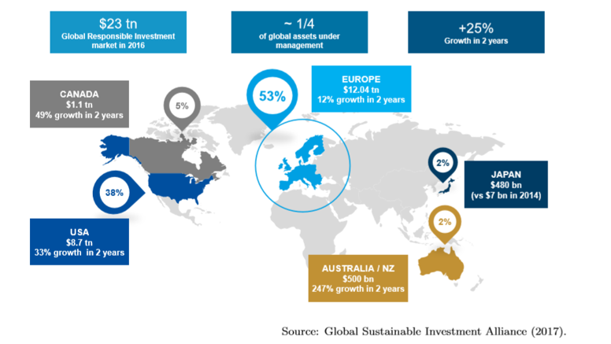
Social trends

Slide 20
Traditional approach
Rules-based scoring systems:
Human implementation
Slow, subjective, questionable
No evidence of sustainability

Slide 21
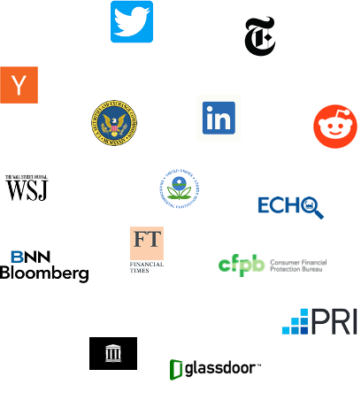
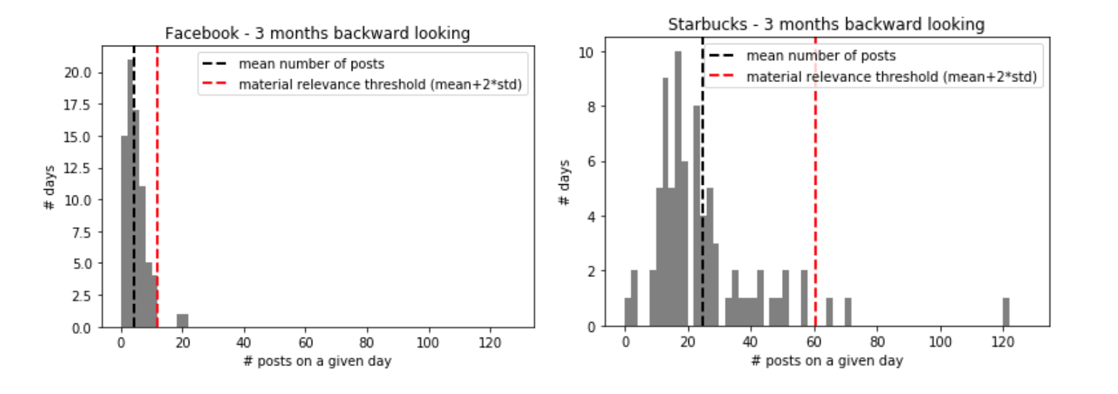
Our approach (4 years ago)
Data sources
Analyze via NLP
Determine materiality

Slide 22
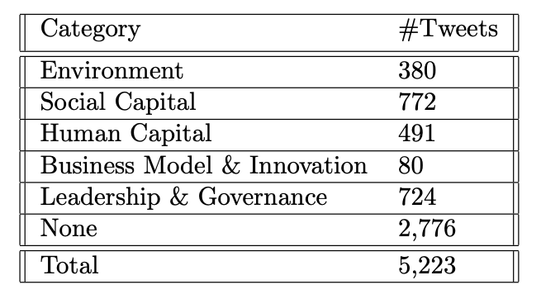
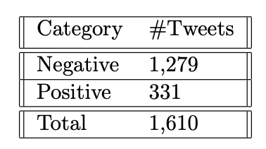
Interpreting the data

Slide 23
BERT methods
Bidirectional Encoder Representations from Transformers
A neural network-based technique for natural language processing pre-training: discern the context of words
Spam filters, search engines, etc.

Slide 24
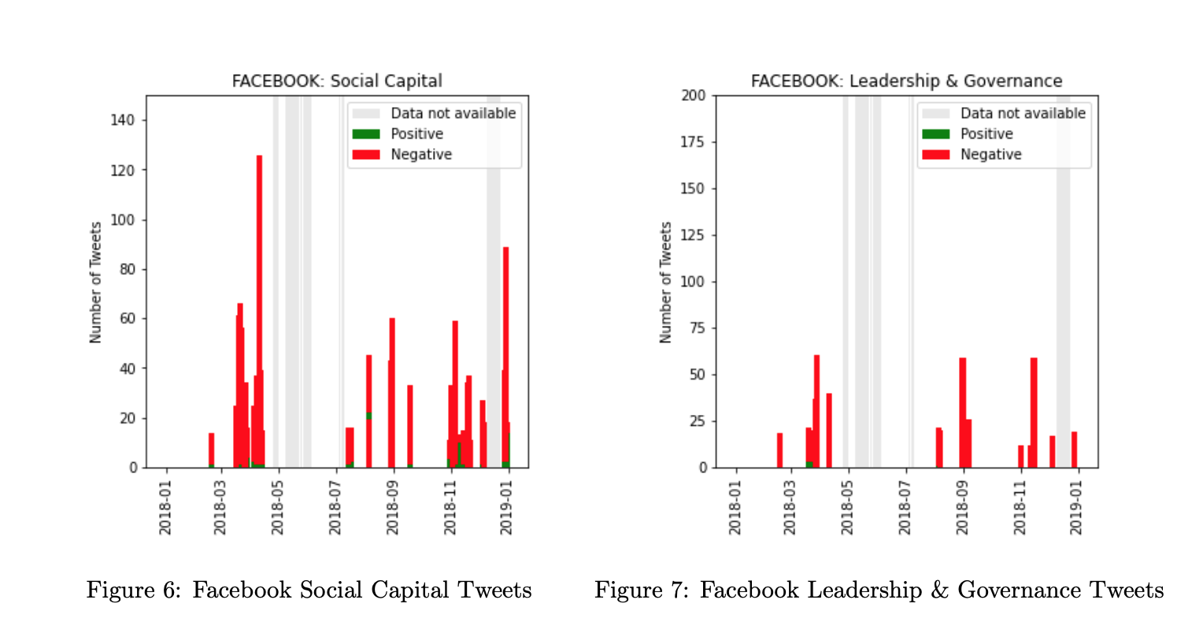
Facebook business case 1

Slide 25
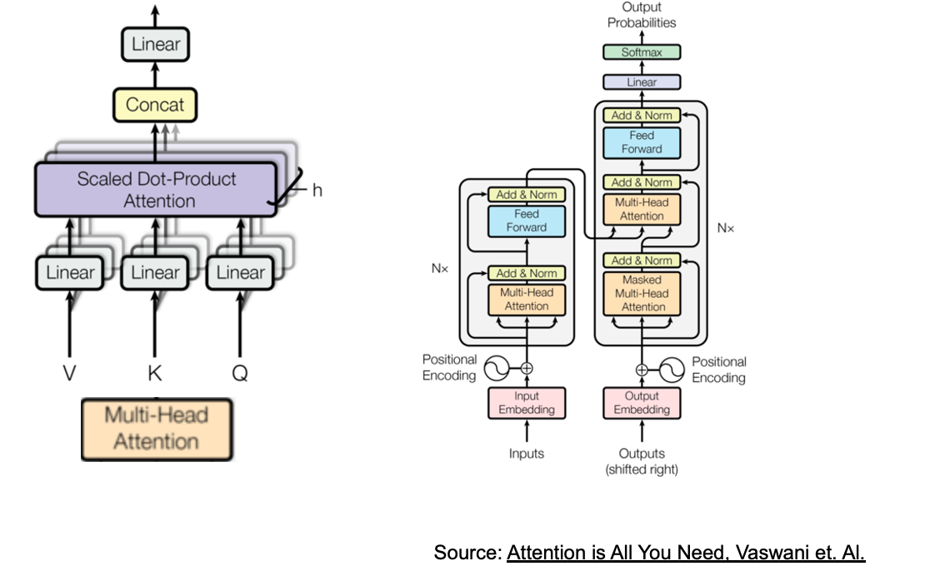
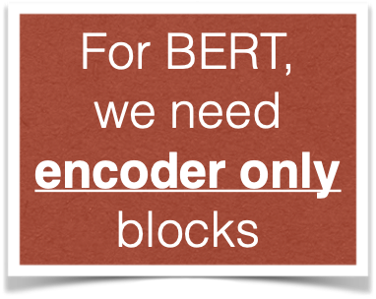
Transformers & ESG
State-of-the-art natural language processing allows for high-performing NLP models,
even for complex subject matter areas,
and even under weak supervision

Slide 26
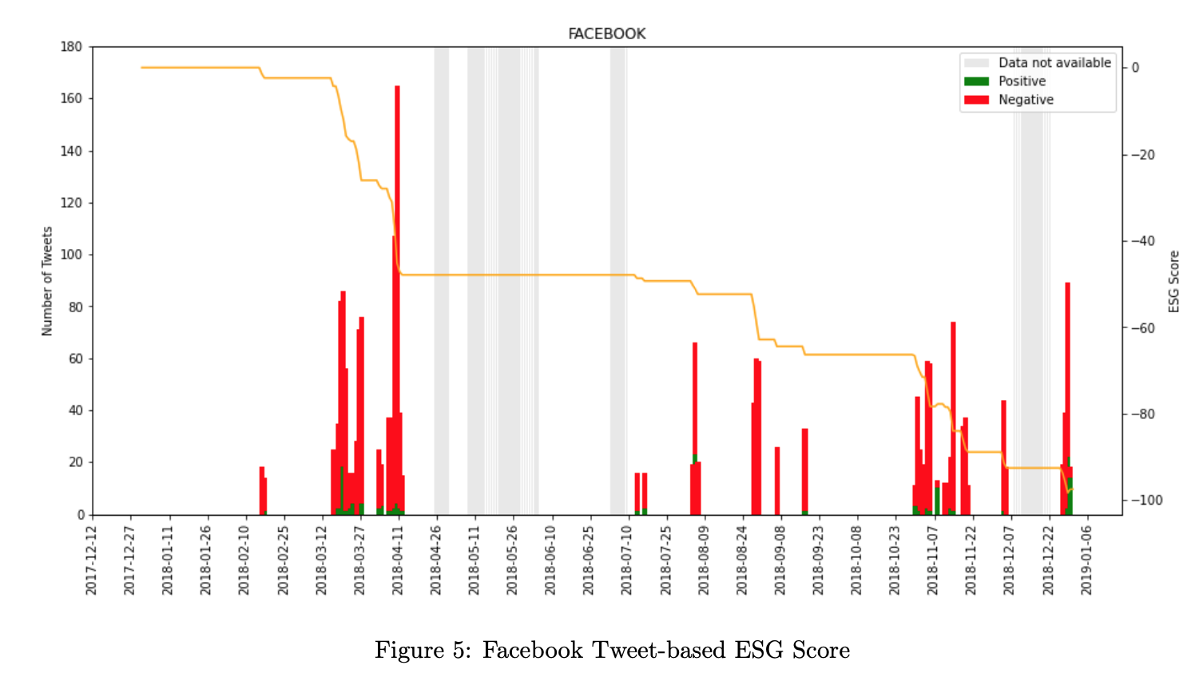
Facebook business case 2

Slide 27
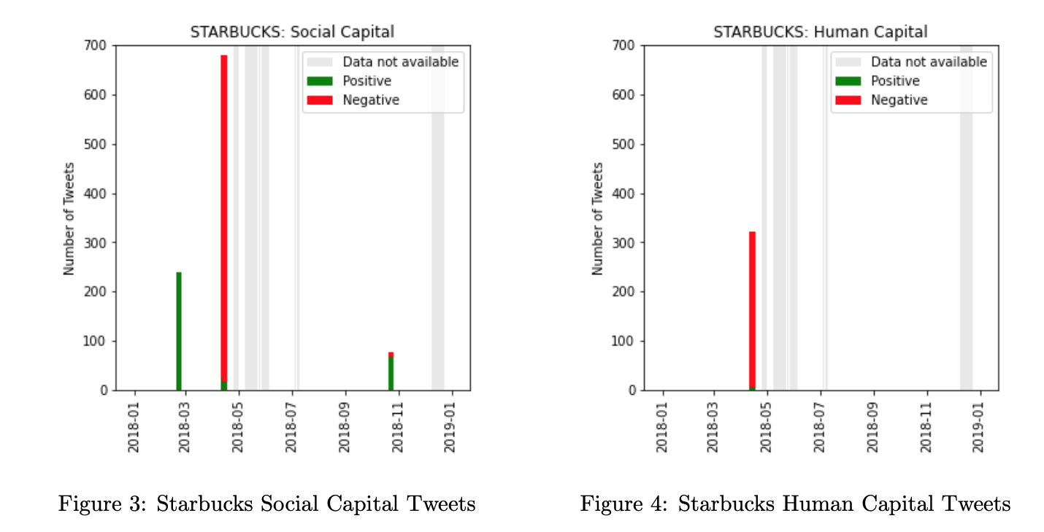
Facebook business case 3

Slide 28
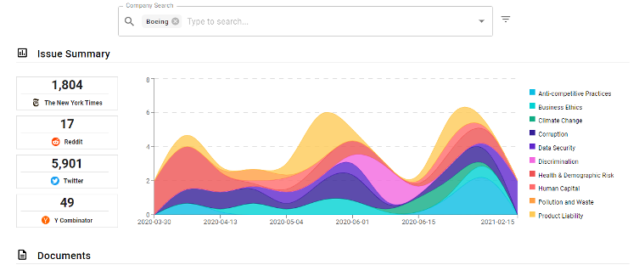
Responsibli (today, LLM)

Slide 29
Artificial Intelligence in “scoring”
Construct ESG scores using web-resident, text data sources
Company document centres
Sentiment analysis sourced in real time
News sources
The need for AI infrastructure

Slide 30
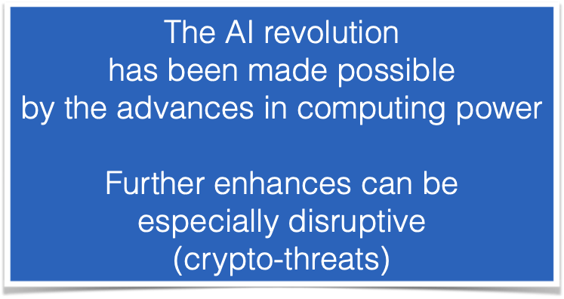
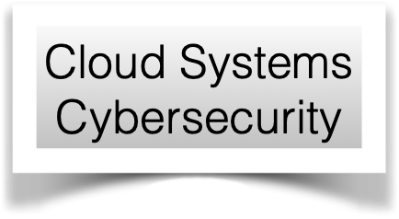
Traditional Technology Architecture
FREE
Commodity
Deep
Learning
Algorithms
Hardware
Data
Gold

Slide 31
Technology Architecture Innovation
Hardware+Software
DATA

Slide 32
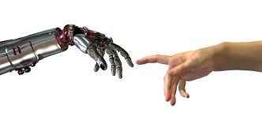
Data-based approach
Traditional data sources are being replaced by unstructured data sources
Social media
Sensor data
Document databases
Numbers
Database
Images
Algorithms will have to adapt
Words

Slide 33
Digital assets
Country -fiat- currencies
Cryptocurrencies - payment vehicles
New coins linked to new “financial objects”
Sport funds and more
Data-driven deals
Carbon credits
Green bonds

Slide 34
A Sports Fund
Professional player
Generates cashflows later
Receives financing now

Slide 35
Securitization
Creates a market
(BlockChain)
Creates a coin
(currency)
Professional player
Generates cashflows later
Value increases over time
Issues units (stock)
Receives financing now

Slide 36
Application: Urban sustainability
The Risk Exchange

Slide 37
Decision making
Game 1
Game 2
$900
$-900
Choice A:
100%
Choice A:
100%
$1000
$-1000
90%
90%
Choice B:
Choice B:
$0
$0
10%
10%

Slide 38
Game theory
Same Game!
$900
$-900
Choice A:
100%
Choice A:
100%
1
2
Two Players
$1000
$-1000
90%
90%
Choice B:
If they disagree on the value
they trade with each other
Choice B:
$0
$0
10%
10%

Slide 39
China and Babylonia
Code of Hammurabi, c. 1750 BC
If a merchant received a loan to fund his shipment, he would pay the lender an additional sum in exchange for the lender's guarantee to cancel the loan should the shipment be stolen or lost at sea.

Slide 40
Osaka
The Dōjima Rice Exchange (堂島米市場), Osaka
Established in 1697
Consumers and producers negotiated the future price of rice: a futures exchange
Future commitment
BID
Rice
Exchange
ASK
Future price determined
via an auction mechanism
-Committed
-No default risk

Slide 41
Chicago
In the 19th century, agricultural products where traded all over the North American midwest
One of those centres, Chicago, developed the concept of the clearing house.
The concept was so powerful, that it became the dominant centre, sending all others into oblivion

Slide 42
The Risk Exchange
Buyers
Sellers

Slide 43
Social assets

Slide 44
The new financial world
More currencies (tokens) than people
Currencies to exchange risk
Technology infrastructure that:
Settles in real-time
Transparent
Cheap
Does not distinguish between buyer and seller
Regulation
Compliance
Tax

Slide 45
Köszönöm
תודה
Спасибі
Thanks
ありがとう
Gracias
cảm ơn
ευχαριστώ
감사해요
Kösz
Dankon
Teşekkürler
Danke
متشکرم
Merci
Grazie
tack
rahmat
Takk
谢谢
ਧੰਨਵਾਦ
Gratias
dzięki
спасибо
धन्यवादा
ขอบใจ
شكرًا
asante
dankie
շնորհակալություն

